Slide 1

Customer Shopping Behavior Analysis
An End-to-End Data Analytics Project
Prepared by: Hriday Halder
PYTHON (PANDAS)
POSTGRESQL
SQL
INTERACTIVE DASHBOARD

Slide 2
Project Overview
Uncovering Customer Insights
This project analyzes customer shopping behavior from raw data to actionable insights.
1
2
3
How do customers shop?
Who spends more?
Do discounts increase revenue?
Understanding purchasing patterns.
Identifying high-value segments.
Evaluating promotional effectiveness.

Slide 3
Project Goals
Key questions driving our analysis:
Understand Customer Purchasing Behavior
Deep dive into habits and preferences.
Identify High-Value Customer Segments
Focus on profitable customer groups.
Measure Impact of Discounts & Subscriptions
Quantify promotional effectiveness.
Analyze Product Performance & Satisfaction
Evaluate product success and customer feedback.
Present Interactive Insights
Dashboard for easy decision-making.

Slide 4
Dataset Understanding
A comprehensive view of customer interactions.
👤 Customer Demographics
🚚 Shipping Type
Age, Gender
Standard, Express, etc.
🛍️ Purchase Behavior
⭐ Customer Review Ratings
Amount, Frequency
Feedback on products
📦 Product Details
🔁 Previous Purchase History
Category, Item Purchased
Loyalty indicators
💸 Discount & Promotion
Combined Data
Usage data
For behavioral and financial insights.

Slide 5

Data Preparation & Feature Engineering (Python)
Transforming raw data into meaningful insights.
Handling Missing Values
Initial Exploration
Median imputation for review ratings within categories.
Structure, missing values, summary statistics.
Feature Engineering
Data Standardization
Age group segmentation, numeric purchase frequency, discount optimization.
Lowercase column names, underscore spaces, clear labeling.

Slide 6

Database Integration (PostgreSQL)
Storing and managing data for efficient analysis.
Database: customer_behavior
Table: customer
Cleaned and prepared data loaded here.
Structured environment for our data.
Benefits
Fast querying for rapid insights.
Advanced SQL capabilities (CTEs, window functions).
Seamless dashboard integration.

Slide 7

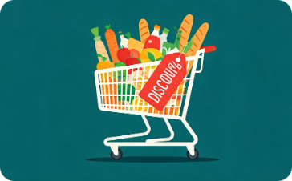

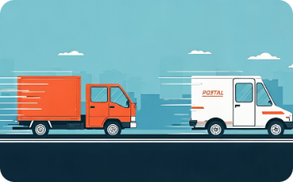
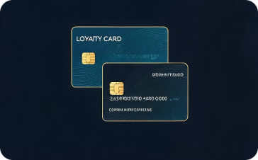
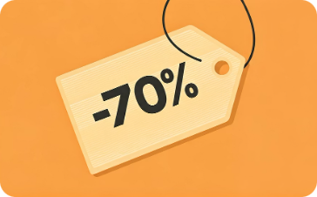
Business Questions & SQL Insights
Answering critical business questions with data-driven queries.
Q1: Male vs. Female Revenue
Q2: Discount User Spending
Q3: Product Satisfaction
Q4: Shipping Type & Spending
Based on average review ratings.
Target gender-based marketing strategies.
Identify high-value customers even with discounts.
Compare average purchase for Standard vs. Express.
Q5: Subscriber Spending
Q6: Product Discount Dependency
Evaluate financial value of subscription programs.
Optimize discount strategies for specific products.

Slide 8


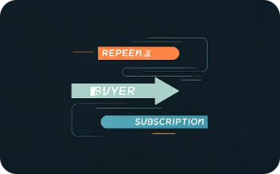
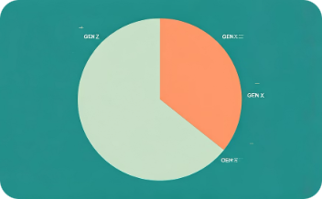
Advanced SQL Insights
Deeper analysis into customer behavior and product performance.
Q7: Customer Segmentation by Loyalty
Q8: Top 3 Best-Selling Products
Q9: Repeat Buyers & Subscriptions
Q10: Age Group Revenue Contribution
Identifies category leaders using window functions.
Connects customer loyalty with subscription behavior.
Revenue share and percentage contribution by age group.
New, Returning, Loyal. Understand lifecycle and retention.

Slide 9
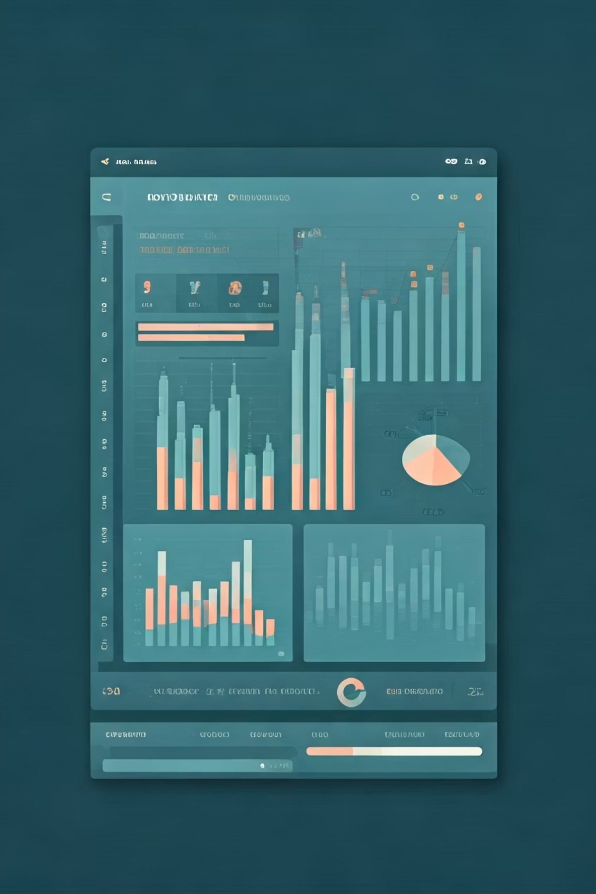
Key Insights & Business Impact
Transforming data into strategic actions.
✨ Key Observations:
📈 Business Impact:
Certain age groups drive significant revenue.
Subscribers generally spend more.
Loyal customers generate strong revenue.
Discounts drive volume, not always value.
Express shipping correlates with higher spending.
Improve targeted marketing campaigns.
Optimize discount strategies.
Enhance customer retention programs.
Identify high-performing products.
Make data-driven pricing & shipping decisions.
This project demonstrates a complete data analytics workflow, showcasing strong analytical, technical, and business-thinking skills.

